Slide 1
Workshop in Software Models
Delivery Drone Project
Guy Haviv
Noa Davidovitch

Slide 2
Spectra Requirements
Full functioning Delivery Drone based on variables, guarantees and assumptions which are declared and synthesized using Spectra language.
Maintain a request & delivery drone system between houses and warehouse
Every request must be picked up eventually
Every request picked up, must be delivered to its destination eventually
Each location holds only one request before pickup – the last one sent
Default Drone inventory includes room for 5 envelopes and 2 packages
Drone must drop off package/envelope when it can
Drone must stay put if there is no request to pickup/ drop off
Changing movement policy with regards to winds
Changing pickup policy with regards priority packages from the warehouse
Managing pickups with a limited battery

Slide 3
GUI Requirements
GUI representation of the Spectra controller’s system simulation
GUI displaying all Spectra components in the specification
Houses, warehouse, charging station etc.
Responsive GUI - updates in accordance with the controller’s system responses
Clear and meaningful visual representation for each component and the system’s state
Easy UI menu components:
Adding requests (controlling environment variables)
Switching modes (manual / automatic)
Executing pre-defined scenarios

Slide 4

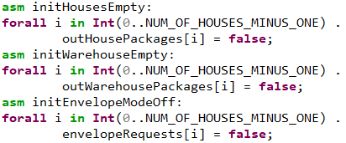
Spectra Specification –Basic Environment & Basic Assumptions
Basic environment include 3 boolean arrays:
outHousePackages[i]- represent new request from house #(i+1) to the warehouse.
outWarehousePackages[i]- represent new request from warehouse to house #(i+1)
envelopeRequests[i]- represent if the request from house #(i+1) is an envelope.
Assumptions:
At initial state:
No requests from houses.
No requests from warehouse.
All envelope requests are off.
Request can not disappear:
For each house and warehouse request can pickup or stay.
Example:

Slide 5

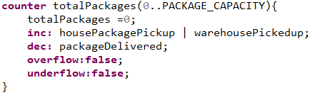
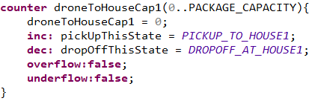
Spectra Specification – System & Counters (Inventory system)
3 system variables:
Drone - array of 2 Cord to represent the drone location on the grid.
PickUpThisState - Enum represent current pickup by location.
DropOffThisState - Enum represent current drop-off by location.
7 counters:
4 counters (one for each house): count packages on the drone for each house destination.
2 counters : count how many packages/envelopes on the drone are destined to warehouse.
1 counter : count total number of packages on the drone.
Examples:

Slide 6
Spectra Specification – Defines
Locations – atWarehouse, atHouse#, atChargingStation
Coordinates on the grid of those locations.
The locations can be changed.
Capacity – PACKAGE_CAPACITY, ENVELOPE_CAPACITY
Maximum packages/envelopes the drone can held in his inventory.
All capacities are parameterized and can be changed.
Pickup – housePickedup, warehousePickedup, housePackagePickup
true if the drone is picking up request from house/warehouse.
Delivered – packageDelivered, envelopeDelivered
true if the drone is dropping off package/envelope.
Room for pickup- roomForPickupPackage, roomForPickupEnvelope
true if the drone inventory is not full.
Stay- drone stay at the same coordinates

Slide 7


Spectra Specification – Guarantees (drone movement & pick-up mechanism)
Drone movement:
Drone can move up to one step both row and column directions.
Base on the predicates:
Drone can not move when it has nothing to do
Pick up mechanism:
Use pattern pResponseToS - every waiting request must be picked up eventually.
Pick up can be made only if there is room on the drone, the drone at location,
and there is a waiting request.

Slide 8
Spectra Specification – Guarantees (drop-off mechanism)
Drop off mechanism:
Use pattern pResponseToS - if the drone has package/envelope to specific location, it eventually be there.
Drop off iff the drone is at the location and its capacity to this location is not empty.
If drone has package/envelope to specific location and it is in the same location, it will not move until drop off.

Slide 9

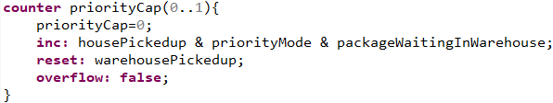
Spectra Specification – Priority Mode
Environment & assumption:
priorityMode initialized to false
When true - warehouse packages are prioritized for pick-up over house requests.
Drone can pick up only up to priorityCap # of packages before a warehouse package.
1 counter:
Counts how many house packages were picked up while in priority mode, up to priorityCap.
1 guarantee:
By default, only one request can be picked up before priority request.

Slide 10

Spectra Specification – Winds Mode
Environment & assumption:
windsMode initialized to false
When true - the drone can only move sideways )not diagonally(.
1 guarantee:
Drone moves both coordinates (including diagonally) means no winds are on.

Slide 11
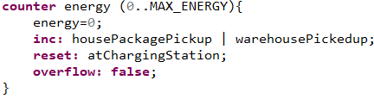
Spectra Specification – Energy
Define how many packages the drone can pick up before his battery empties.
1 counter:
Counts how many packages were picked up since the last visit in the charging station.
1 guarantee:
Battery should never be empty.
Notice: envelopes are light, as such, they do not count against the energy counter.

Slide 12
Spectra Variants
Native Variants:
There are three modulable features that can be “turned off” at the specidication files.
Winds, Priority, Energy.
In the specification files there are comments regarding which line should be commented out in order to turn off each feature, independently.
Extra Variants:
Charge when needed: drone can not go to charging station before picking up at least X packages (X is parameters).
Must pick up: drone can not leave a house location if it has a waiting request.
This specification variant includes only winds & energy features (i.e no priority).
No ‘must drop off’: canceling the drone requirement for a drop-off when eligible (at location, with a package to drop off)
Less moves:
Reducing drone steps:
When drone has no more tasks (no requests nor drop-offs) - it returns to the warehouse after at most 2 other steps.
Don't stagger in a house - when visiting a house, after 1 safety state for drop off, it does not visit that house for at least 4 states.
After every pickup Drone must drop off that package/envelope after at most 2 other steps.
This specification variant includes only energy features (i.e no winds nor priority).

Slide 13
Spectra Variants
Unrealizable:
Must pick up –priority:
Tries to enforce pickup without considering cases which the drone cannot make a pickup.
Such as when priority mode is true and can not pick up any more requests from houses (priorityCap is maxed).
Must pick up –drop off:
Must drop off force the drone making a drop off the moment it can.
System can only decide on a single dropOffThisState value.
Regularly this is made realizable since the drone can decide to only carry either house packages OR house envelopes.
Must-pick-up it picks up every request it runs into so it might carry both types – contradiction.
Must pick up –warehouse:
Tries to enforce pickup of packages from warehouse.
Less moves:
Tries enforce the drone after drop off, if there is a request, pick it up in at most 3 steps.

Slide 14
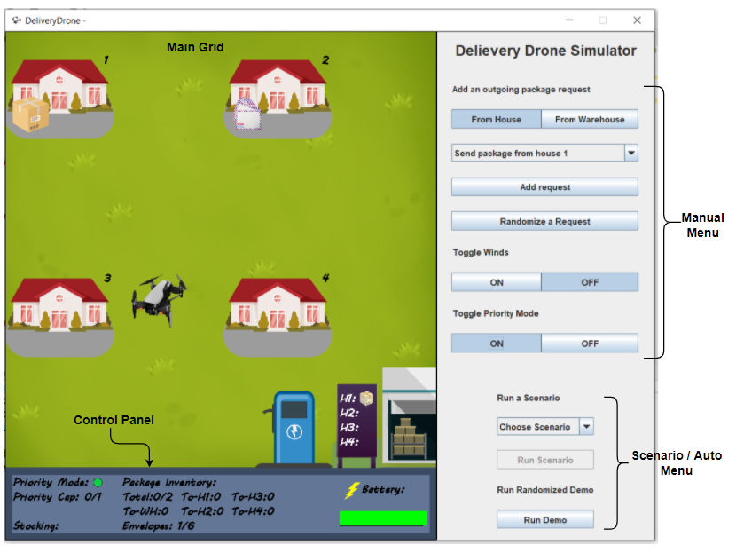
Simulation – Main Screen
Built of 3 main components:
Main Grid
Houses
Waiting deliveries on the left
Dropped deliveries on the right
Warehouse Board
Shows waiting deliveries
Charging station
Drone – moving between locations
Control Panel
Menus

Slide 15
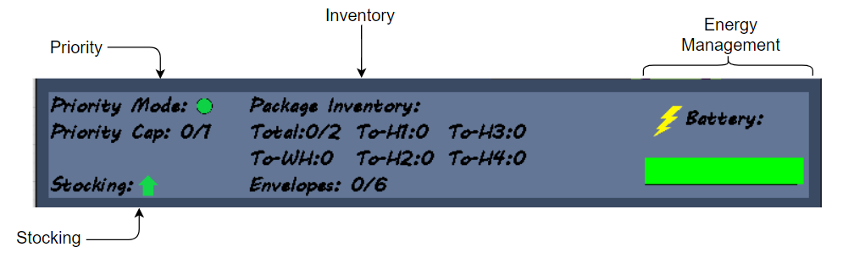
Simulation – Control Panel
Priority
Indicator if mode is ON/OFF
Current capacity of the priority cap
Stocking - Reflects if the drone picks up / drops off a package in this state
Battery – indicates drone’s remaining energy
Inventory
Current capacity of the drone’s inventory – both for packages and envelopes
For packages – shows distribution by destination

Slide 16
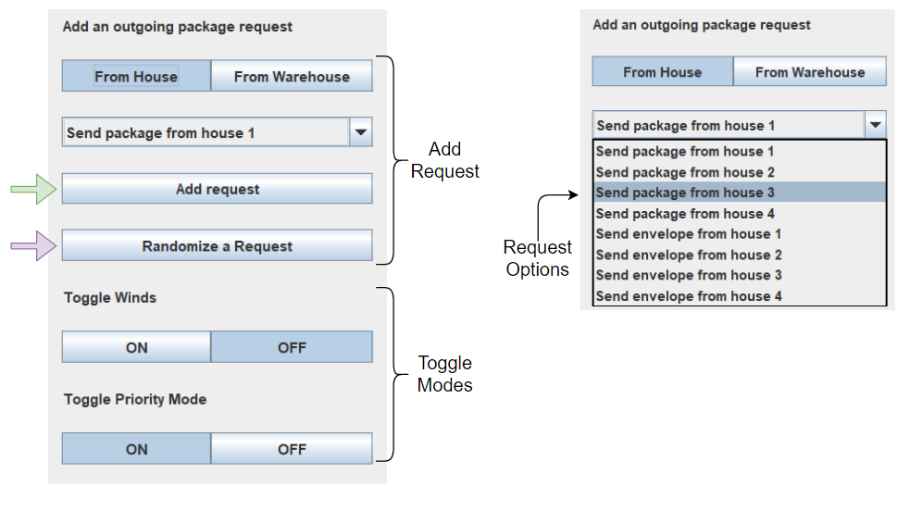
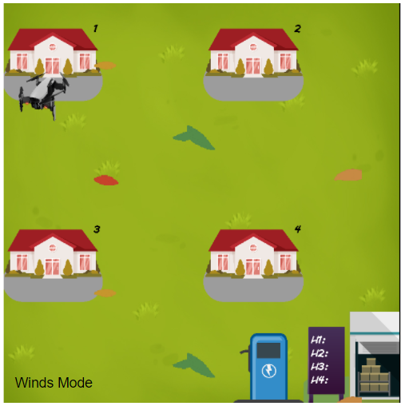
Simulation - Menus
Manual Menu
Add requests
Select source (toggle button)
Select type and destination from the dropdown menu
Click “Add request”
You can also just “Randomize a request” for a quick add
Toggle Modes – both visually and as an environment variable
Winds Mode
Priority Mode

Slide 17
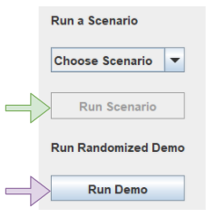
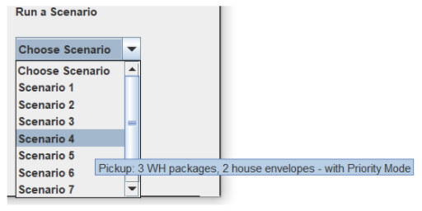
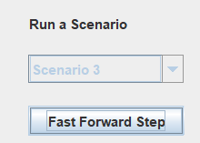
Simulation - Menus
Scenario / Auto Menu
Run Demo – start automized environment
Run Scenario – choose a scenario from the dropdown list, each one has a tooltip with the scenario description
Fast forward step button – when running a scenario, you can speed up the simulation to run fast through a step.

Slide 18
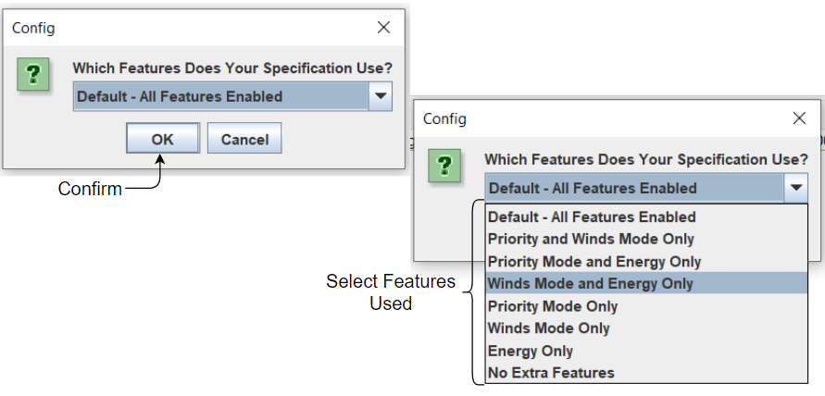
Simulation – Configuration Screen
Optional UI solution for enabling modulization of the specification advanced features
At startup, simply select which features are enabled in your specification file – the GUI will adjust accordingly

Slide 19
Pre-defined Scenarios
Scenario No. | # of Steps | Description | Comments
1 | 2 | A package is sent from the warehouse to a random house | Most basic drone operation
2 | 1 | All houses request a package or an envelope delivery | Check enforcement of drone’s inventory system - with default capacity of 2 packages.
3 | 1 | Priority mode, with no warehouse packages | Priority Mode is nullified when warehouse is empty
4 | 1 | Pickup only: 3 warehouse packages, 2 house envelopes - with Priority Mode | Testing priority mode behavior
5 | 5 | Pickup only: all houses request package delivery, with a 4-package refill after a pickup. Partial use of Winds Mode | Keeping houses requests full longer, test winds mode behavior

Slide 20
Pre-defined Scenarios
Scenario No. | # of Steps | Description | Comments
6 | 1 | Full Delivery of Full Grid, - All houses request delivery, warehouse full as well. With Winds Mode | Busiest scenario
7 | 5 | Full Delivery: Carousel of house packages - Requests coming in cycle (1,2,4,3) | Interesting when inventory capacity allows pickup for all packages
8 | 2 | On-the-way Pickup: Random WH request to a house, upon pickup - add delivery request from that house. Full Delivery of house request. | Check if the drone will pickup a waiting package where he makes a drop-off

